Slide 1
Sustaining Cradle-to-Grave Control of Radioactive Sources (INT-9182) Meeting on the development, revision and implementation of the safety case and safety assessment Indonesia, 15 – 19 May 2017
Background and workshop objectives, scope, agenda, approach
Radioactive Waste and Spent Fuel Management Unit
Waste and Environmental Safety Section (WES),
Division of Radiation Transport and Waste Safety (NSRW)
Department of Nuclear Safety and Security

Slide 2
Partnerships
The Sustaining Cradle-to-Grave Control of Radioactive Sources Project (INT-9182) is conducted and implemented by the IAEA
Funding is provided by:
European Union
Spain
United States
IAEA (through the Technical Co-operation Fund)
“The views expressed in this publication do not necessarily
reflect the views of the European Commission.”

Slide 3
Project Partners
Strategic, technical and financial partners:
European Commission
United States of America:
US NRC
US DOE/NNSA
Spain:
Consejo de Seguridad Nuclear
Canada:
Canadian Nuclear Safety Commission

Slide 4
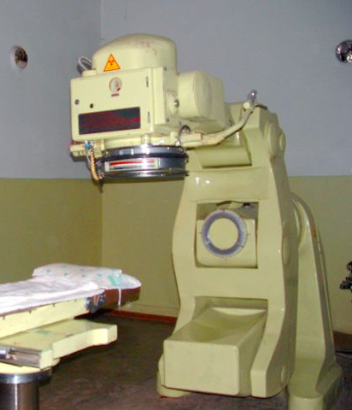
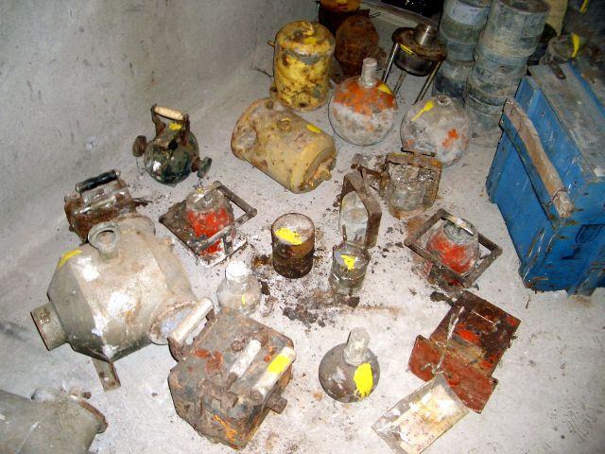
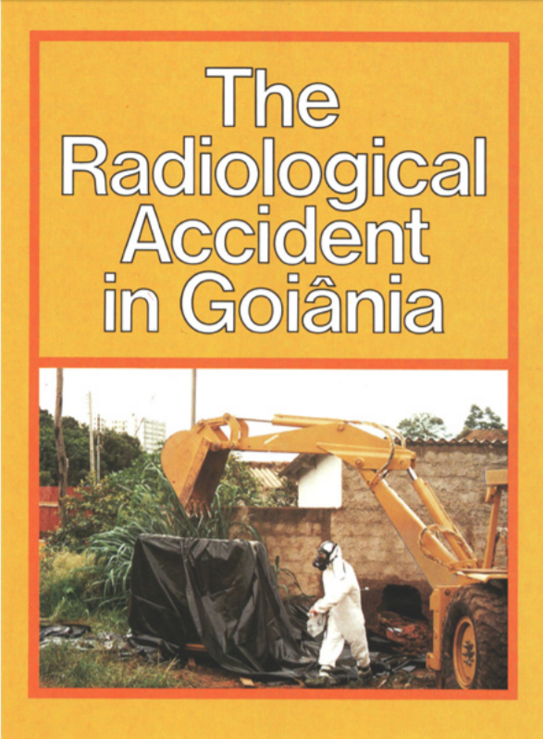
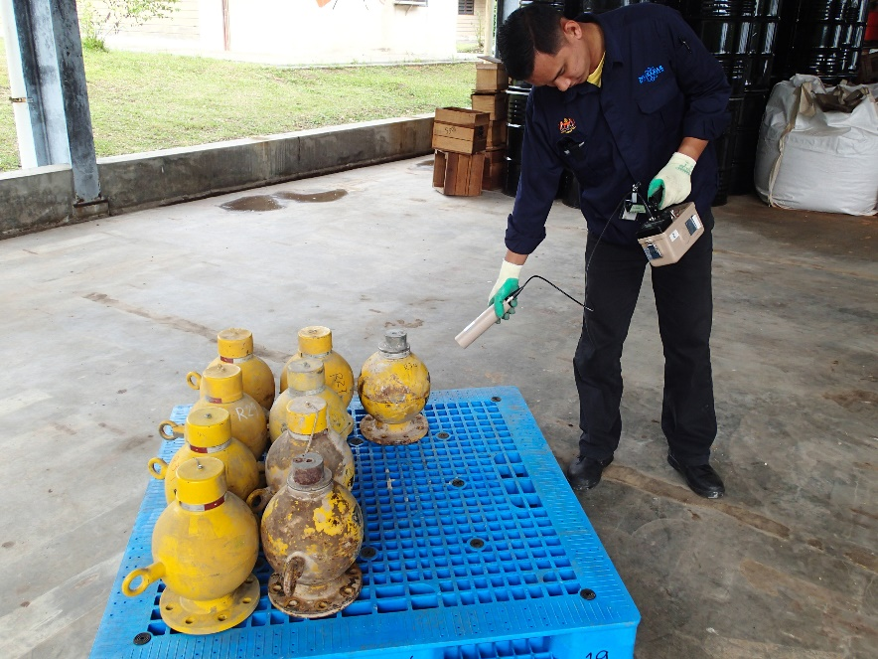
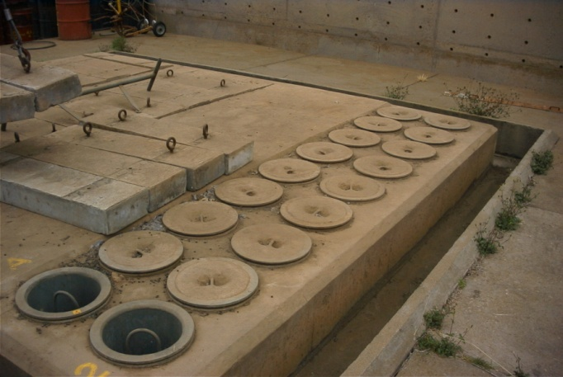
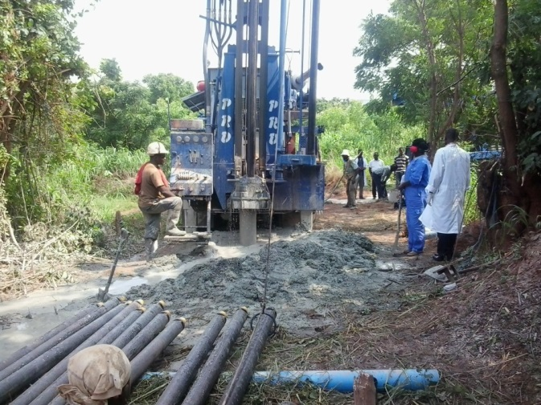
The Cradle to Grave Project
Many different situations to control

Slide 5
This Workshop
A cooperation between the International Atomic Energy Agency (IAEA) and the Government of Indonesia through the Indonesian National Nuclear Energy Agency (BAPETEN)
The primary purpose of the meeting is to provide training and advice on development, revision and implementation of the safety case and safety assessment for waste management facilities (stores and disposal facilities)
To be achieved through key presentations and by exchanging experiences amongst participating states

Slide 6
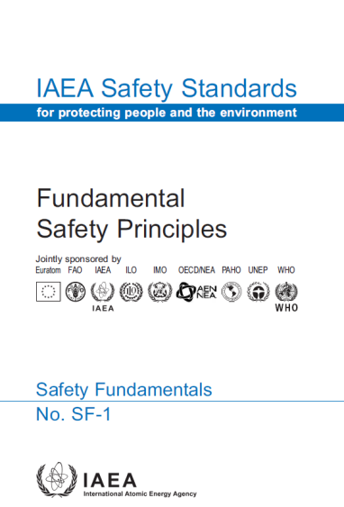
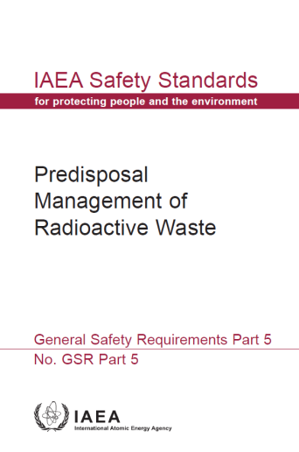
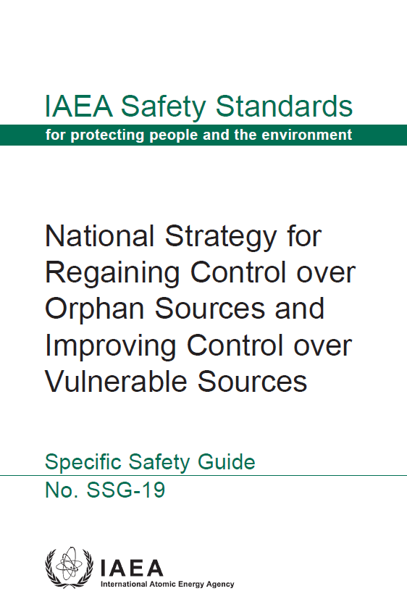
IAEA Safety Standards
Fundamental Safety Principles
Requirements – Legal, Technical, & Procedural Safety Imperatives
Safety Fundamentals
Safety Requirements
Guidance on Best Practice to meet Requirements
Safety Guides

Slide 7
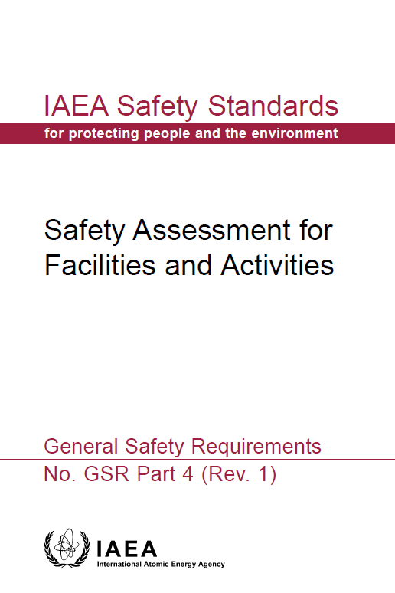
Key Safety Standards for this Workshop

Slide 8
Key Requirements
Legal & Regulatory Framework
Policy on safety
Policy on waste
Independent regulatory body
Licensing regime
Clear responsibilities for safety – primarily the operator
Strategy for waste management
Safety case
Safety assessments
Radiological protection programme
Security arrangements
Monitoring
Inspection & enforcement
Waste acceptance criteria
Periodic review
Working procedures
Management system

Slide 9
Workshop Scope
The meeting is designed to cover:
the safety requirements relevant to the management and disposal of sealed radioactive sources (SRS)
the management options for SRS at different stages of their lifecycle
operational and post-closure safety assessments
the safety case; its components, development and uses

Slide 10
Agenda – Broad Outline
Introductory sessions and key presentations
National presentations I
Site Visit
National presentations II
Summary and Discussion
Close
Monday
Tuesday
Wednesday
Thursday
Friday morning
11:00 on Friday

Slide 11
National Presentations
Follow the template→
Aim for 25 minutes presentation +5 minutes for discussion
Template:
Brief description of the facilities
Status of Safety Case / Safety Assessment
Scope and contents of the SC/SA
Details of the safety assessment

Slide 12
Synthesis and Reporting
Friday morning: facilitators will report back to the whole meeting with summary presentations/discussions:
Status of understanding, development and use of safety cases and safety assessments
Key issues concerning the safety case and safety assessment faced in the countries
Where there might be a need for further discussions, information exchange, training, high priority projects, cooperation etc…

Slide 13
Thank you!
Notes:
Thank you!

