Slide 1
Sustaining Cradle-to-Grave Control of Radioactive Sources (INT-9182) Meeting on the development, revision and implementation of the safety case and safety assessment Indonesia, 15 – 19 May 2017
Status of Safety Cases and Safety Assessments for National Waste Management Facilities for DSRS in Cuba.
Radioactive Waste and Spent Fuel Management Unit
Waste and Environmental Safety Section (WES),
Division of Radiation Transport and Waste Safety (NSRW)
Department of Nuclear Safety and Security

Slide 2
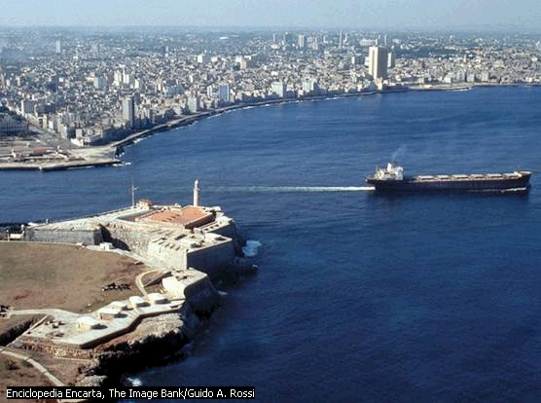

Slide 3
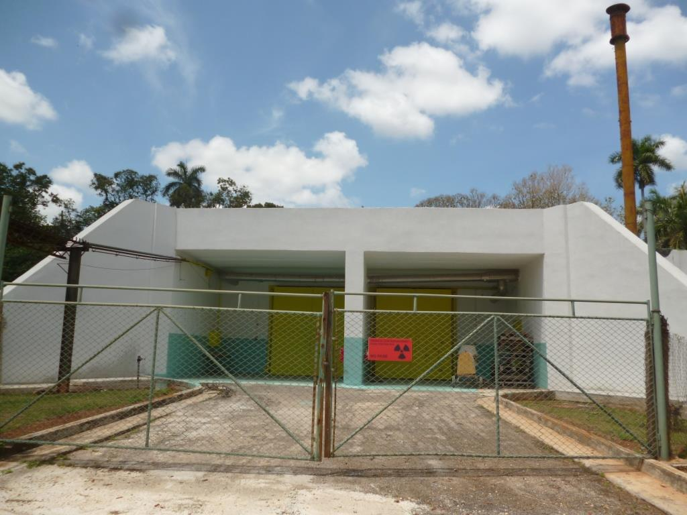
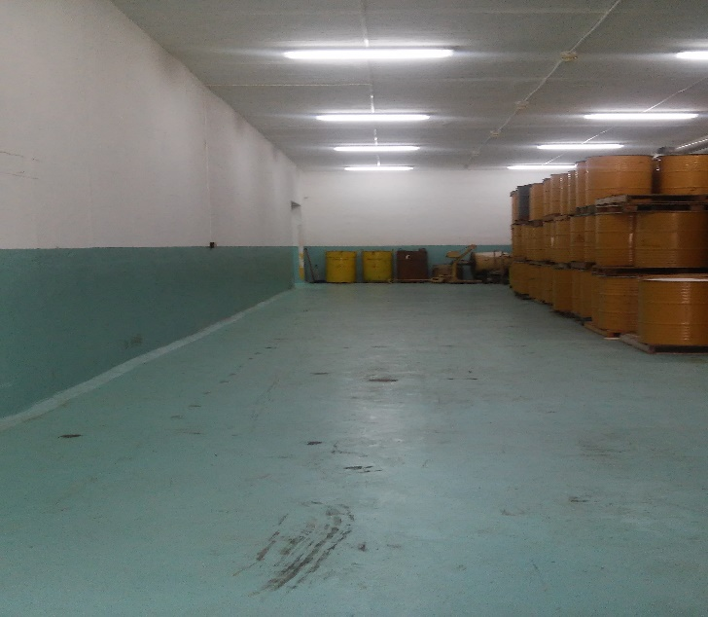
National Waste Management Facilities for DSRS
Facilities:
The CPHR has two facilities for Radioactive Waste Management, the Storage Facility of Radioactive Waste and disused sources and the Radioactive Waste Treatment Plant.

Slide 4
National Waste Management Facilities for DSRS
Facilities:
The storage facility is a surface construction located on a zeolite filler 1 meter thick and composed of two interconnected rooms of 6 x 21 x 4.5 meters each and a ventilation room located on the side of the storage area.
The plant has a technological area, destined to perform several operations of treatment and conditioning of radioactive waste and disused sources and to the control and exit of conditioned packages to the storage facility, a laboratory where make operations related to the conditioning of sources that involve greater risks, an area for reception, segregation of radioactive waste and disused sources and the dismantling of devices for the recovery of the sources associated with them, an area for the storage of radioactive waste pending treatment and a room for decay of radioactive waste prior to its declassification.

Slide 5
Centralized Facilities of management radioactive waste and disused sources
CNSN
CPHR
(Storage and
Plant)
CPHR

Slide 6
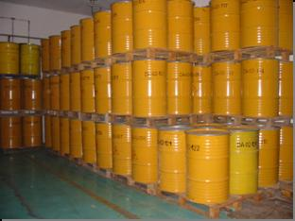
Status of Safety Case / Safety Assessment for DSRS Stores
There is a first version of the SC/SA, revised and formally approved by the Regulatory Authority.
It is provided to have a second version for the 2018, aiming to the renewal of the Operation License.
The PRO, the operator of facilities and the Regulatory Authority have copies of the SC/SA.

Slide 7
Status of Safety Case / Safety Assessment for DSRS Stores
Scope and contents of the SC/SA
The SC/SA cover the operation stage.
They are include the management system, operating procedures, monitoring arrangements, and safety assessment.
The emergency plan is an independent document.

Slide 8
Status of Safety Case / Safety Assessment for DSRS Stores
The safety assessment include:
Estimation of exposure dose during normal operation (occupational and public exposures).
Estimation of potential doses for emergencies or radiological accidents or events.
Identification of accident initiating events for each stage of the process.
Description of the severity of the potential consequences associated with the accident initiating events.
Description, for each initiating event, of safety barriers to prevent or mitigate accidents.
Risk assessment.
Environmental radiological assessment.

Slide 9
Status of Safety Case / Safety Assessment for DSRS Stores
Normal operations include:
Reception and segregation of radioactive wastes and disused sources.
Storage of radioactive wastes and disused sealed sources.
Clearance of radioactive wastes.
Dismantling of devices and recovery of associated radioactive sources.
Conditioning of disused radioactive sources (categories 3 – 5).

Slide 10
Status of Safety Case / Safety Assessment for DSRS Stores
The methodology of risk matrix was used.
We identified 48 initiating events:
Human errors
External Events
Drop of packages with radioactive materials
Leakage of sources.
Attempted unauthorized access
Fire

Slide 11
Status of Safety Case / Safety Assessment for DSRS Stores
Exposures was quantified using:
Point source model.
Scenarios of document “Dangerous quantities of radioactive material (D-values)”, Emergency Preparedness and Response, EPR-D-VALUES-2006, Vienna (2006).
Scenarios of document “Radionuclide and Radiation Protection Data Handbook”, Radiation Protection Dosimetry Vol. 98 No 1, 2002.
Scenarios of IAEA-TECDOC 1162: “Generic procedures for assessment and response during a radiological emergency”.

Slide 12
Status of Safety Case / Safety Assessment for DSRS Stores
The results of the assessment are used to:
Define additional safety measures / barriers.
Improvement of the radiation protection program.
Establishment of the radiological emergency plan.
Establishment of monitoring plan of facilities.
Definition of the limits and operating conditions.

Slide 13
National Waste Management Facilities for DSRS
Disposal facilities
The country does not have facilities for the disposal of radioactive wastes and disused sealed sources.
Currently working on the development of a national strategy for the disposal of radioactive wastes.

Slide 14
Thank you!
Notes:
Thank you!

