Slide 1
Sustaining Cradle-to-Grave Control of Radioactive Sources (INT-9182) Meeting on the development, revision and implementation of the safety case and safety assessment Indonesia, 15 – 19 May 2017
Status of Safety Cases and Safety Assessments for Moroccan Long Term Storage Facility
-EL ABBARI Younes, FADIL Najib
(CNESTEN)
-SADIQ Younes
(AMSSNuR)

Slide 2
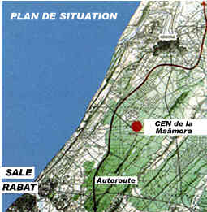
National Waste Management Facilities for DSRS
Description of the facility:
The legislation in Morocco (law n° 17-83) determines that the responsibility for the management of radioactive waste is carried by the National Centre of Nuclear Energy, Sciences and Techniques (CNESTEN).
Centralized waste management facilities was established by CNESTEN and licensed by regulatory body base on the safety analysis report.
CENM is located 22 km north of Rabat-Salé, 8 km to the east of the Atlantic coast and it covers an area of 24.75 hectares.

Slide 3
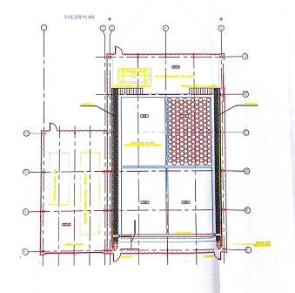
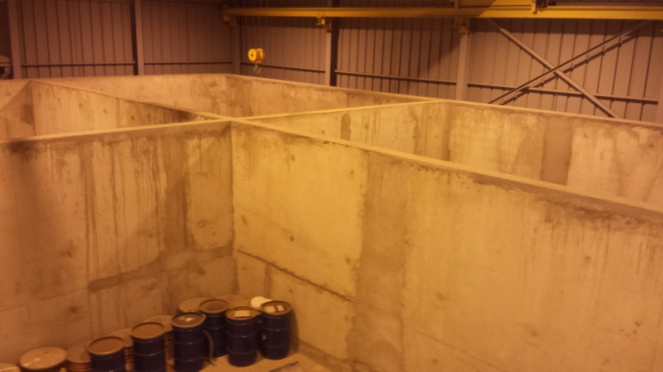
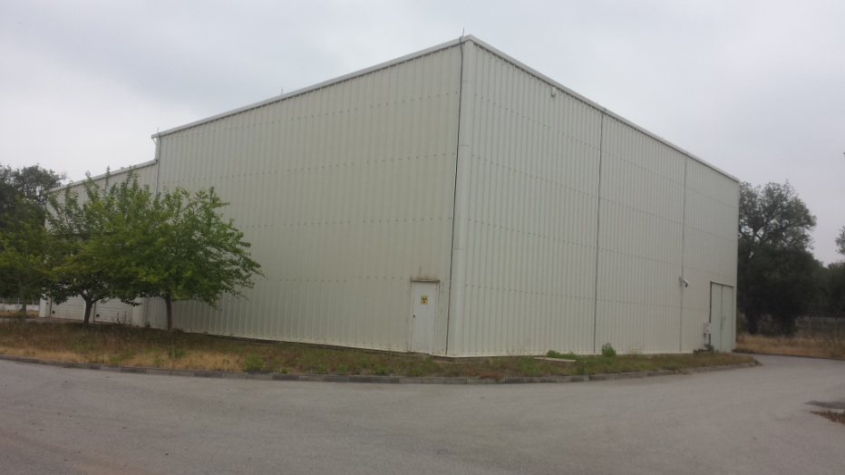
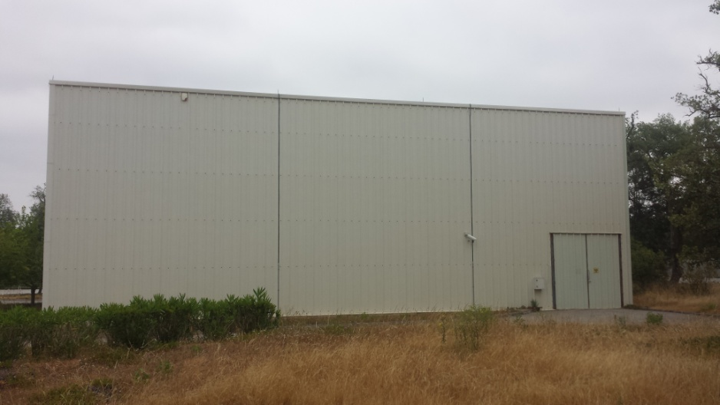
National Waste Management Facilities for DSRS
Description of the facility:
Long term storage facility: it consists of four vaults with a surface area of 52 m² for each one ,a height of 3.5 m, and a capacity of 616 drums/vault. The thickness of the concrete walls is 0.40 m.

Slide 4
National Waste Management Facilities for DSRS
The application for authorization of Nuclear Facilities and Nuclear Activities, as well as Final Disposal Facilities, the content of which is laid down by regulation, must include facility safety analysis report including a site selection evaluation report and an environmental impact assessment of the Installation, an internal emergency plan and a physical protection plan, updated in the different phases of authorization.

Slide 5
National Waste Management Facilities for DSRS
For the existing store facility , there is a Final Safety Case
The SC document was reviewed by a safety commission constituted by representatives from the ministry of health, the ministry of Interior, the ministry of Energy and Mine and the Environment Department
It Has been formally approved, Therefore we have our operation licence
A copy of this document is kept by the operator (CNESTEN) and a copy kept by RB

Slide 6
National Waste Management Facilities for DSRS
Draft document to apply for authorisation for modification of the conditioning of DSRS in working shields to the dismantlement of DSRS, and to demonstrate the safety of dismantlement, conditioning and storage of Category 3 to 5 DSRS as well as to determine any actions necessary for the improvement of safety.

Slide 7
National Waste Management Facilities for DSRS
Scope and contents of the SC/SA for the store(s)
Decree No.2-94-666 concerning the authorizations and control of nuclear installations states that the following steps in the lifecycle of nuclear installations are subject to authorization:
Construction
Discharges of radioactive liquid and gaseous effluents
Commissioning
Operation
Decommissioning

Slide 8
National Waste Management Facilities for DSRS
Scope and contents of the SC/SA for the store(s)
1/5-Construction authorization
The Article 7 (decree No.2-94-666) related to the construction authorization in this decree states that: Construction authorization application must be accompanied by a preliminary safety analysis report. This report includes the following chapters:
General description of the site
Geography
Risk assessment due to air traffic
Demography
Meteorology
Descriptive geology and geotechnical
Dynamic Geology and Seismicity
Hydrology
Hydrogeology
Radiological baseline

Slide 9
National Waste Management Facilities for DSRS
Scope and contents of the SC/SA for the store(s)
2/5-Authorization of discharges of liquid and gaseous radioactive effluents
Article 9 (decree No.2-94-666): The application for authorization of discharges of liquid and gaseous radioactive effluents must be accompanied by a document giving information about systems intended for the treatment of liquid and gaseous effluents to maintain the amount and concentration of the discharged effluents into prescribed limits.

Slide 10
National Waste Management Facilities for DSRS
Scope and contents of the SC/SA for the store(s)
3/5-Commissioning authorization
Article 12 decree (No.2-94-666): The application for Commissioning tests authorization must be accompanied by a provisional safety analysis report. This report contains , notably:
The design of the nuclear facility and Its operating procedures;
Analysis of postulated accidents and the ability of safety systems to limit the consequences.

Slide 11
National Waste Management Facilities for DSRS
Scope and contents of the SC/SA for the store(s)
4/5-Operation authorization
The application for authorization of operation must be accompanied by the definitive safety report which shall include in particular:
1-The results of commissioning tests.
2-The operational programs and the detailed procedures for operating the installation, including:
normal operation ;
incidents and accidents expected.

Slide 12
National Waste Management Facilities for DSRS
The safety assessment covers both Occupational exposures and Public exposures
Normal operational exposures: regarding the storage facility it covers all the operation performed inside this facility: Storing the final packages of radioactive waste, surveillance operations, maintenance operations....
Accidents and emergency situations: Fire in a vault full of RW packages (drums), Dropping a waste package ...

Slide 13
Status of Safety Case / Safety Assessment for DSRS Stores
The exposure scenarios were identified and described Based on the operational programs and the adopted procedures for operating the installation
Exposures were quantified Using the hot spot-software
The assessment results are used:
to manage/optimise worker doses
to define monitoring plans

Slide 14
Thank you!
Notes:
Thank you!

